Slide 1
Natural Language Processing (NLP) with Python — Tutorial
Instructor :
Engineer Saeed

Slide 2
What is Natural Language Processing (NLP)?
Natural language processing (NLP), the goal is to make computers understand the unstructured text and retrieve meaningful pieces of information from it. Natural language Processing (NLP) is a subfield of artificial intelligence, in which its depth involves the interactions between computers and humans.
The deep-learning sequence-processing models introduced in the following sections can use text to produce a basic form of natural-language understanding

Slide 3
Applications of NLP:
Machine Translation.
Speech Recognition.
Sentiment Analysis
Question Answering.
Summarization of Text.
Chabot.
Intelligent Systems.

Slide 4
Applications of NLP:
Text Classifications.
Character Recognition.
Spell Checking.
Spam Detection.
Autocomplete.
Named Entity Recognition.
Predictive Typing.

Slide 5
Natural Language Processing
Deep learning for natural-language processing is pattern recognition applied to words, sentences, and paragraphs.
Segment text into words, and transform each word into a vector.
Segment text into characters, and transform each character into a vector
The different units into which you can break down text (words, characters, or n-grams) are called tokens, and breaking text into such tokens is called tokenization.

Slide 6
word embedding
There are multiple ways to associate a vector with a token. In this section, I’ll present two major ones: one-hot encoding of tokens, and token embedding (typically used exclusively for words, and called word embedding).
Word embedding are learned from data. It’s common to see word embedding that are 256-dimensional, 512-dimensional, or 1,024-dimensional when dealing with very large vocabularies.

Slide 7
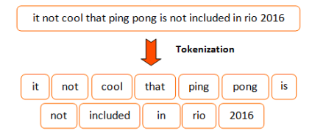
Tokenization | word embedding

Slide 8
Practical Work
Thanks for Listening:

